Slide 2

Criteria for Onboarding of Additional States onto the SURWASH Programme
Monday, 2nd December 2024

Slide 3
Introduction and Background of the SURWASH Programme

Slide 4
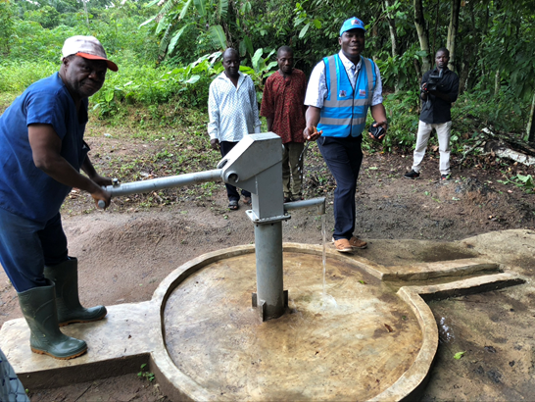
State of Emergency in the Nigeria’s WASH Sector
Inadequate WASH in Nigeria leads to 73% of the total burden of enteric infections and 255,000+ preventable deaths each year.
Insufficient Sector Investment: Nigeria invests average of 0.32% GDP annually; much less than African Average of 0.7%. At least 1.30% is required through 2030 to achieve the SDGs.
Poor Sanitation and Hygiene: 46 million Nigerians practice Open Defecation.
Limited Drinking Water Access: 60 million Nigerians without access to basic drinking water.
Non-functional Infrastructure: 38% of improved water points are non-functional.
Failing Urban Utilities: Piped water access declined from 32% in 1990 to 7% in 2019.
Inadequate School and Healthcare Facilities: only 14% of schools and 7% of healthcare facilities have basic water supply and sanitation services.

Slide 5

National Action Plan: Revitalization of the WASH Sector
The National Action Plan for Revitalisation of the WASH Sector (NAP) is Government’s overall strategy and vehicle for investment and sector reforms to attain SDGs for WASH.
NAP launched in Nov. 2018 by President Buhari with Declaration of ‘State of Emergency’.
The NAP has 5 Components: Governance, Sustainability, Sanitation, M&E and Funding.
To key in, State governments are to develop own 5-year action plans, translated into investment plans.
Encompasses 2 sub-programs to ensure that marginalized subsectors are properly supported:
PEWASH for rural WASH
Launched in 2015 (prior to AP) to achieve equitable and sustainable access to WASH in rural communities by 2030
Clean Nigeria Campaign for sanitation
Launched in 2019 as the sanitation sub-program
Recognizes the historic neglect of sanitation relative to water

Slide 6
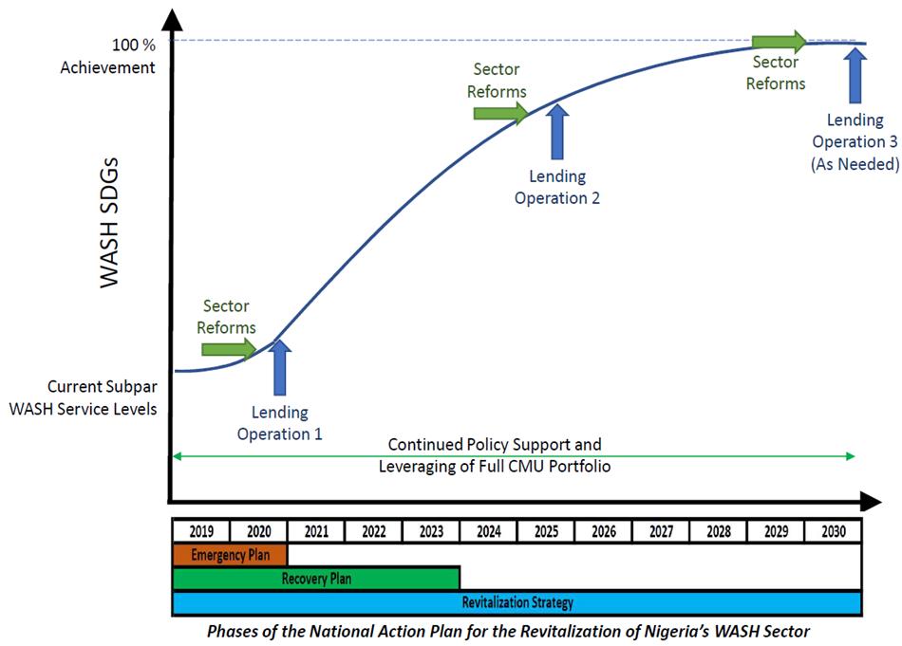
SURWASH Programme Development Objectives
To increase access to water, sanitation, and hygiene services and to strengthen sector institutions in select states of Nigeria
Result Areas:
RA 1: Strengthened sector policies and institutions for improved services
RA 2: Improved access to water supply, sanitation and hygiene services

Slide 7
SURWASH Financing Modalities & Expected Result
$700M WB Loan: $640M Program for Results (PforR) for Investment Financing
$60M Investment Project Financing Technical Assistance(TA)
Expected Results
6,100,000 people provided with basic drinking water services
1,400,000 people provided with access to improved sanitation services
500 ODF+ verified communities
2,000 schools and Health Care Facilities with improved WASH services

Slide 8
Disbursement Linked Indicators (DLIs)
RA 1: Strengthened Sector Policies and Institutions for Improved Services
DLI 1 | National WASH Fund established and operational.
DLI 2 | Design and implementation of a State PIR Plan to achieve required reforms.
RA 2: Improved Access to Water Supply, Sanitation and Hygiene Services
DLI 3 | People provided with basic drinking water service under the Program.
 | Sub-DLI 3.1: Performance improvement of state water supply sector institutions and service providers.
DLI 4 | People with access to a sustainably functioning water service.
DLI 5 | Households with improved sanitation facilities constructed or rehabilitated under the Program.
 | Sub-DLI 5.1: Performance improvement of state sanitation sector institutions and service providers.
DLI 6 | Communities having achieved community-wide sanitation status (ODF+) or number of ODF+ communities having maintained their status.
DLI 7 | Schools and healthcare facilities with functional, improved water supply, sanitation and handwashing facilities constructed or rehabilitated under the Program.

Slide 9
Platform Approach Open to all States
Program States
Must express interest and meet Eligibility and Readiness Criteria
Initial states selected for inclusion in the Program (PforR) by the FMWR against Eligibility and Readiness Criteria in a fair and transparent process
Access to both PforR and IPF to support and incentivize: (1) infrastructure investment and (2) strengthening of policies and institutions
Allocations under PforR and IPF are notional, with final allocations determined based upon performance
Additional states may be incorporated into the Program during implementation
Notes:
Choose states to be able to conduct assessments and finalize design

Slide 10
Eligibility Criteria for onboarding new States onto the SURWASH Programme

Slide 11

Step 1: Mandatory Criteria
S/No | Eligibility Criteria | Means of Verification
1 | Expression of interest by the State Governor to participate in the Program and submission of requested evidence to assess eligibility and readiness | Letter submitted by the State Governor to the Federal Government clearly stating interest to participate in the Program accompanied by the requested evidence to assess eligibility and readiness

Slide 12
Step 1: Mandatory Criteria cont…
S/No | Eligibility Criteria | Means of Verification
2 | Acceptance of Program Requirements | A list of prioritized LGAs for investment according to the prioritization criteria in the Program Documents Security Risk Index at an acceptable level within prioritized LGAs which allows for an acceptable cost-benefit analysis

Slide 13
Prospective states should commit to an LGA-wide integrated approach to WASH which invests progressively in LGAs according to a set of prioritization criteria
The LGA Prioritisation process shall consider the following aspects:
Functional LGA WASH Department;
Willingness to par participate in the Program;
Low access to WASH coverage;
High prevalence of WASH related diseases;
LGA WASH Plan for five years;
Open defecation status of the LGA;
Co-location/convergence with other human capital focused operations in the state
Signing of MoU with communities; and
Security Risk Index at an acceptable level for operations

Slide 14
Step 1: Mandatory Criteria cont…
S/No | Eligibility Criteria | Means of Verification
3 | Commitment to national WASH initiatives and programs. At least 2 out of the following 3 must be met: State-level action plan for the revitalization of the WASH sector PEWASH Partnership Agreement State-level campaign to end open defecation in accordance with the Clean Nigeria: Use the Toilet campaign has been launched | At least 2 out of the following 3 must be sent and verified: State-level action plan for the revitalization of the WASH sector as approved by the relevant authorities Signed PEWASH Partnership Agreement Evidence of implementation of comprehensive awareness campaigns to end open defecation in accordance with the Clean Nigeria: Use the Toilet campaign

Slide 15
Step 2: Scored Criteria
№ | Eligibility Criteria | Urban | Small Towns | Rural | Means of Verification (3 points per evidence)
 |  | Score (%)
1 | Institutional Arrangements and Capacity for the past 5 years | 15 | 15 | 15 | Official documentation naming the implementing agency(ies) for water supply and sanitation and their mandate Current staff resumes, qualifications, and records of relevant experience Training materials, workshop reports, and evidence of capacity building initiatives for the indicated period Minutes of coordination meetings, MOUs, and collaboration agreements for the indicated period Budget documents, resource allocation plans, and financial reports for agency(ies) for indicated period

Slide 16
Step 2: Scored Criteria cont…
№ | Eligibility Criteria | Urban | Small Towns | Rural | Means of Verification (3 points per evidence)
 |  | Score (%)
2 | Commitment to carry out institutional reform in the WASH sector for the past 5 years | 15 | 15 | 15 | Copies of current relevant policies, regulations, and legislative documents for the WASH sector Documentation of current governance structures, accountability frameworks, and oversight reports Training materials, workshop reports, and evidence of capacity building initiatives related to reform activities for the indicated period Minutes of stakeholder meetings, consultation reports, and feedback mechanisms related to reform activities for the indicated period Budget documents, financial reports, and evidence of allocated funds for reform activities for indicated period

Slide 17
Step 2: Scored Criteria cont…
№ | Eligibility Criteria | Urban | Small Towns | Rural | Means of Verification (6 points per evidence)
 |  | Score (%)
3 | Planning and Implementation Capacity for Water Supply Projects for the past 5 years | 30 | 30 | 30 | Review of current approved investment plans, master plans or business plans for completeness and quality Review of available feasibility studies for completeness and quality. Review of minutes of past stakeholder meetings or consultation reports with beneficiary communities for the indicated period Evidence of previous successful construction projects, project management plans, and staff qualifications for the indicated period Budget documents and financial reports showing allocated funds for water supply projects for the indicated period

Slide 18
Step 2: Scored Criteria cont…
№ | Eligibility Criteria | Urban | Small Towns | Rural | Means of Verification (6 points per evidence)
 |  | Score (%)
4 | Planning and Implementation Capacity for Sanitation Projects for the past 5 years | 30 | 30 | 30 | Documentation of sanitation campaigns, community outreach programs, and behaviour change communication materials for the indicated period Evidence of market development plans, support programs for local sanitation enterprises, and partnerships with private sector entities for the indicated period Review of minutes of past stakeholder meetings or consultation reports with beneficiary communities for the indicated period Training materials, workshop reports, and evidence of capacity building initiatives for the indicated period Budget documents, financial reports, and evidence of allocated funds for sanitation projects for the indicated period

Slide 19
Step 2: Scored Criteria cont…
№ | Eligibility Criteria | Urban | Small Towns | Rural | Means of Verification
 |  | Score (%)
5 | Budgetary Performance for the past 5 years | 10 | 10 | 10 | For each year (2019, 2020, 2021, 2022 and 2023), provide evidence of allocated funds, funds received, and funds utilized

Slide 20
Step 3: Combined State Score
Evaluation of each subsector (urban, rural, small towns) using unified criteria with differentiated scores,
Summarise scores in the consolidated table below to find the overall state score using assigned weights.
Subsector | Weight | Subsector Score | Weighted Score
Urban | 30
Small Towns | 40
Rural | 30
Overall State Score

Slide 21
Readiness Criteria for onboarding new States onto the SURWASH Programme

Slide 22
Step 1: Mandatory Criteria
S/No | Eligibility Criteria | Means of Verification
1 | Expression of interest by the State Governor to participate in the Program and submission of requested evidence to assess eligibility and readiness | Letter submitted by the State Governor to the Federal Government clearly stating interest to participate in the Program accompanied by the requested evidence to assess eligibility and readiness.

Slide 23
Step 1: Mandatory Criteria cont…
S/No | Eligibility Criteria | Means of Verification
2 | Availability of a Program Investment Plan | The letter from the Governor should be accompanied by a list of projects and activities to be financed under the SURWASH Program indicating their scope, costs, timelines, expected outcomes, and level of readiness.

Slide 24
Step 1: Mandatory Criteria cont…
S/No | Eligibility Criteria | Means of Verification
3 | Completion of assessments by the World Bank: Technical Fiduciary Systems Environmental and Social Systems | Addenda to the following reports based on the investment plan provided: Technical assessment report Fiduciary Systems assessment report Environmental and Social Systems assessment report

Slide 25
Step 2: Scored Criteria
№ | Eligibility Criteria | Urban | Small Towns | Rural | Means of Verification (6 points per evidence)
 |  | Score (%)
1 | Readiness of water supply activities | 30 | 30 | 30 | Preliminary or detailed engineering design reports for identified projects Stakeholder Engagement Plan or equivalent available to consult and engage beneficiary communities Bid documents and packages Staff qualifications, resumes, and records of relevant experience including resume of procurement officer with experience with state procurement laws and procedures Plans for construction supervision.

Slide 26
Step 2: Scored Criteria cont…
№ | Eligibility Criteria | U | ST | Rural | Means of Verification (6 points per evidence)
 |  | Score (%)
2 | Readiness of sanitation activities | 30 | 30 | 30 | Documentation of planned sanitation campaigns, community outreach programs, and behavior change communication materials Documentation of market development plans and partnerships with private sector entities Documentation of planned financial incentives, subsidies, or grants provided to sanitation businesses or households to increase coverage Staff qualifications, resumes, and records of relevant experience Plans for M&E and reporting on the performance and impact of interventions

Slide 27
Step 2: Scored Criteria cont…
№ | Eligibility Criteria | U | ST | Rural | Means of Verification (2 points per evidence)
 |  | Score (%)
3 | Adequate environmental and social (E&S) risk management policies and capacities | 10 | 10 | 10 | Staff qualifications, resumes, and records of relevant training and experience with at least one officer in each Implementing Agency with at least 3 years of experience in implementation of E&S safeguards activities Established E&S Policies to manage construction activities, including OHS, labour recruitment, safety of workers, payment of wages, grievance management, GBV policies, etc. Approved Procedure for land acquisition, resettlement and compensation E&S screening reports, assessment documents or E&S management plans available for some of the identified sub-projects Regular E&S compliance reports and monitoring records

Slide 28
Step 2: Scored Criteria cont…
№ | Eligibility Criteria | U | ST | Rural | Means of Verification (2 points per evidence)
 |  | Score (%)
4 | Monitoring, evaluation and reporting mechanism in place | 10 | 10 | 10 | Evidence of Baseline data reports and datasets for proposed sub-projects M&E staff rosters, resumes, qualifications, and records of relevant training and experience Regular M&E reports, dashboards, and communication materials Training materials, workshop reports, and evidence of capacity building initiatives Budget documents, financial reports, and evidence of allocated funds for M&E and reporting

Slide 29
Step 2: Scored Criteria cont…
№ | Eligibility Criteria | U | ST | Rural | Means of Verification
 |  | Score (%)
5 | Evidence of allocated budget for 2025 for activities in program investment plan | 20 | 20 | 20 | Provide evidence of allocated funds in state budget for 2025 for the 2025 activities presented in the submitted program investment plan

Slide 30
Step 3: Combined State Score
Evaluation of each subsector (urban, rural, small towns) using unified criteria with differentiated scores,
Summarise scores in the consolidated table below to find the overall state score using assigned weights.
Subsector | Weight | Subsector Score | Weighted Score
Urban | 30
Small Towns | 40
Rural | 30
Overall State Score

Slide 31
Prioritisation Criteria for LGAs

Slide 32
Prospective states should commit to an LGA-wide integrated approach to WASH which invests progressively in LGAs according to a set of prioritization criteria
The LGA Prioritisation process shall consider the following aspects:
Functional LGA WASH Department;
Willingness to par participate in the Program;
Low access to WASH coverage;
High prevalence of WASH related diseases;
LGA WASH Plan for five years;
Open defecation status of the LGA;
Co-location/convergence with other human capital focused operations in the state
Signing of MoU with communities; and
Security Risk Index at an acceptable level for operations

Slide 33
Thank You

